Slide 1
Local data quality
Semantic and structural audit
General principles before local dataset review
Notes:
Suggested duration: 10–12 minutes, including discussion. This session links the shared language of federated analytics and the minimum requirements to a local quality audit. The five facets supply a conceptual frame. The clinical examples and operational checks are workshop applications, supported by the measurement/monitoring survey. The running example is the proportion of completed admissions ending in death. The following session supplies the dataset-specific schema, collection practices and local clinical context.

Slide 2
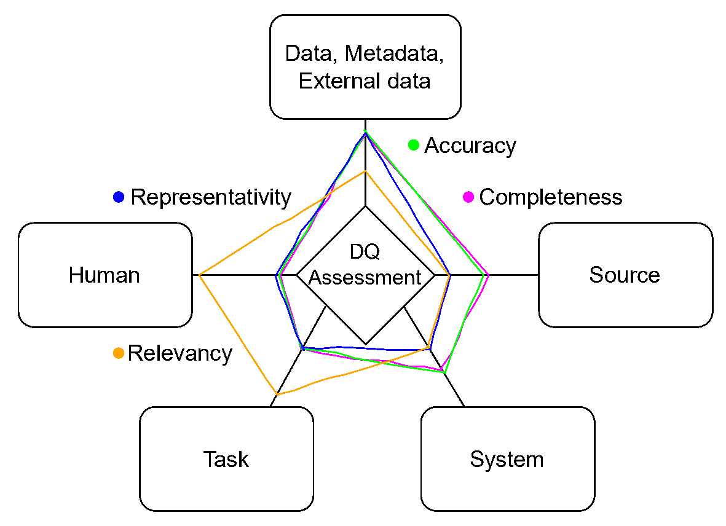
Five facets of data quality assessment
Facets
Evidence and context needed
to assess quality
Quality dimensions
Properties such as accuracy,
completeness and relevance
Mohammed et al. (2025), Figure 1. Conceptual illustration of facet involvement, not quality scores.
Notes:
Suggested time: 75 seconds. Explain the distinction between quality dimensions and facets. Dimensions describe the property to assess, such as completeness or accuracy. Facets identify the evidence and context needed for assessment: the data and metadata, provenance and collection processes, storage/processing systems, the intended task, and the people interpreting the data. Different dimensions draw on different facets. The figure reproduces Figure 1 from the supplied Mohammed et al. paper. The radar-style lines illustrate facet involvement in example quality dimensions. They are conceptual, not measured scores, and should not be read as hospital performance. The authors favour objective automated assessment where feasible, while recognising that some dimensions require human input. The next slide translates the frame into examples from clinical characterisation.
Sources:
Mohammed, S., Ehrlinger, L., Harmouch, H., Naumann, F. and Srivastava, D. (2025). The Five Facets of Data Quality Assessment. SIGMOD Record 54(2), 18–27. Supplied source: Reference papers/Data quality/The Five Facets of Data Quality Assessment.pdf. Figure 1 (p.18), Sections 2–4. Five facets identify ingredients/evidence for assessing quality dimensions. The article proposes a conceptual framework and research agenda, not a validated clinical audit instrument.

Slide 3
Accuracy | Checking whether values reflect reality relies mainly on data and reference information, with some contribution from the source and system.
Completeness | Detecting missing information relies mainly on data and metadata, with collection processes and systems also contributing.
Representativity | Comparing the dataset with a reference population relies mainly on data, including reference distributions.
Relevancy | Deciding whether data are useful depends strongly on the intended task and the people using them.

Slide 4
The five facets in clinical characterisation
Facet | Audit focus | Clinical data example
Data | Meaning and representation | Outcome codes and age units match the dictionary
Source | Collection and transformation | A site’s case report form did not collect smoking
System | Storage and extraction | An export replaces unknown outcomes with zero
Task | Fitness for the clinical question | Mortality needs eligible admissions and known outcomes
Human | Local clinical interpretation | Clinicians explain transfers and follow-up gaps
Notes:
Suggested time: 90 seconds. This table is a clinical workshop adaptation, not a table from the source paper. Each facet provides a different view of the same local dataset. Data covers semantics and representation, including metadata. Source covers how the site collected and transformed data, including whether its case report form ever asked a question. System covers how software stores, extracts and joins the data. Task sets the question and required evidence, such as a completed admission and its discharge outcome. Human provides domain interpretation, including the meaning of transfer and reasons for unascertained outcomes. These examples can overlap facets. There is no one-to-one mapping between a facet and a quality check. Local domain expertise supports interpreting automated findings and the decision about fitness for this analysis.
Sources:
Mohammed, S., Ehrlinger, L., Harmouch, H., Naumann, F. and Srivastava, D. (2025). The Five Facets of Data Quality Assessment. SIGMOD Record 54(2), 18–27. Supplied source: Reference papers/Data quality/The Five Facets of Data Quality Assessment.pdf. Figure 1 (p.18), Sections 2–4. Five facets identify ingredients/evidence for assessing quality dimensions. The article proposes a conceptual framework and research agenda, not a validated clinical audit instrument.

Slide 5
A shared audit for the mortality question
Among completed admissions,
what proportion ended in death?
Shared agreement | Local evidence to check
Unit and eligibility | One eligible completed admission per record
Outcome definition | Death (not easily defined either) or alive at the agreed end of admission
Missingness and denominator | Known outcomes, with unknown outcomes reported separately
Each site checks these rules before sharing its death and admission counts.
Notes:
Suggested time: 70 seconds. Connect the framework to the federated example from presentations 1 and 2. The target question is among completed admissions, what proportion ended in death? Specify the participating population, time period, unit of observation and outcome window. A completed admission must follow a shared rule, with explicit treatment of transfers, ongoing admissions and outcomes not ascertained. The directly observed proportion is among eligible completed admissions with known outcome. Unknown outcomes must be reported separately and the difference from the full target population acknowledged. The local dataset x_i contains the records. The local insight I(x_i) returns D_i, deaths, and N_i, eligible completed admissions with known outcome. Each site applies the same definitions and audit rules before contributing. The aggregate ratio sums D_i and N_i across sites, assuming consistent eligibility and no unintended double counting across sites. This slide translates the five-facet perspective into an audit specification. It is not a new formal quality standard.
Sources:
Mohammed, S., Ehrlinger, L., Harmouch, H., Naumann, F. and Srivastava, D. (2025). The Five Facets of Data Quality Assessment. SIGMOD Record 54(2), 18–27. Supplied source: Reference papers/Data quality/The Five Facets of Data Quality Assessment.pdf. Figure 1 (p.18), Sections 2–4. Five facets identify ingredients/evidence for assessing quality dimensions. The article proposes a conceptual framework and research agenda, not a validated clinical audit instrument.
Miller, R., Chan, S. H. M., Whelan, H. and Gregório, J. (2025). A Comparison of Data Quality Frameworks: A Review. Big Data and Cognitive Computing 9(4), 93. https://doi.org/10.3390/bdcc9040093. Supplied source: Reference papers/Data quality/A Comparison of Data Quality Frameworks.pdf.

Slide 6
Semantic audit: meaning and missingness
Agreement | Clinical example | Local audit question
Concept | Current or ever smoking | Does the site collect the intended concept?
Reference time | Discharge outcome or day 30 | Does the outcome use the agreed window?
Units | Age in years or months | Does mapping preserve the intended value?
Missingness | Not collected, not assessed or unknown | Does a blank retain its source meaning?
A recorded “No” is evidence of absence. A blank needs interpretation.
Notes:
Suggested time: 85 seconds. Data, source, task and human facets help establish meaning. Retain the earlier smoking example: current versus ever smoking describe different concepts. Former smoking needs agreed previous-smoking and cessation/reference-time criteria. A binary current-smoking No combines former and never, and cannot reconstruct those categories. Mapping requires aligned definitions and timing, with information loss recorded. In the mortality example, death at discharge and death by day 30 define different outcomes. Preserve source-specific codes for a variable not collected at a site, an individual not assessed, an unknown response or an unrecorded result. If the source lacks a missingness reason, state that limitation. Do not infer a negative response from a blank. Local clinical and data teams explain collection practice. A syntactically valid category can still mean the wrong clinical concept.
Sources:
Mohammed, S., Ehrlinger, L., Harmouch, H., Naumann, F. and Srivastava, D. (2025). The Five Facets of Data Quality Assessment. SIGMOD Record 54(2), 18–27. Supplied source: Reference papers/Data quality/The Five Facets of Data Quality Assessment.pdf. Figure 1 (p.18), Sections 2–4. Five facets identify ingredients/evidence for assessing quality dimensions. The article proposes a conceptual framework and research agenda, not a validated clinical audit instrument.

Slide 7
Structural audit: representation and counts
Check | Clinical rule or possible error
Schema and codes | Expected fields, types and permitted outcome values
Keys and joins | A join must preserve one row per eligible admission
Dates and ranges | Admission and outcome dates follow the agreed chronology
Completeness | Count unknown outcomes among the admissions checked
The same structural rules protect each site’s numerator and denominator.
Data and system facets. Measurement and monitoring: Ehrlinger and Wöß (2022).
Notes:
Suggested time: 85 seconds. Data and system facets support repeatable checks, while source/task/human information defines meaningful rules. Run checks on a controlled extract and preserve source records. Establish the observation unit first: repeated patients can represent valid readmissions. Check expected columns and data types, allowed values, record keys, referential integrity and joins. Many-to-many joins can multiply admission rows and distort both death and eligible-admission counts. Validate date formats, chronological consistency and clinically justified ranges. Flag implausible or unusual values for review, with correction only from documented evidence. Measure completeness against a specified eligible denominator, retaining missingness categories. Check the extraction/transformation itself, such as defaults for unknown codes. Schema conformance and plausible ranges alone do not establish factual accuracy. Repeat after mapping changes and new extracts.
Sources:
Mohammed, S., Ehrlinger, L., Harmouch, H., Naumann, F. and Srivastava, D. (2025). The Five Facets of Data Quality Assessment. SIGMOD Record 54(2), 18–27. Supplied source: Reference papers/Data quality/The Five Facets of Data Quality Assessment.pdf. Figure 1 (p.18), Sections 2–4. Five facets identify ingredients/evidence for assessing quality dimensions. The article proposes a conceptual framework and research agenda, not a validated clinical audit instrument.
Ehrlinger, L. and Wöß, W. (2022). A Survey of Data Quality Measurement and Monitoring Tools. Frontiers in Big Data 5:850611. https://doi.org/10.3389/fdata.2022.850611. Supplied source: Reference papers/Data quality/a survey on data quality.pdf. Profiling, measurement against rules and recurring monitoring.
Ridzuan, F. and Wan Zainon, W. M. N. (2024). A Review on Data Quality Dimensions for Big Data. Procedia Computer Science 234, 341–348. https://doi.org/10.1016/j.procs.2024.03.008. Supplied source: Reference papers/Data quality/A Review on Data Quality Dimensions for Big Data.pdf.

Slide 8
A missingness error changes the estimate
Recorded outcome | Count
Dead | 10
Alive | 90
Unknown | 20
Among known outcomes
10 / (10 + 90) = 10%
Unknown recoded as “Alive”
10 / (10 + 90 + 20) = 8.3%
The audit checks the code, explains the gap and protects the denominator.
Illustrative example. The true outcome of the 20 unknown records remains unknown.
Notes:
Suggested time: 80 seconds. These are illustrative teaching counts, not notebook output or clinical findings. Ten deaths and ninety alive outcomes yield 10/100 = 10% among known outcomes. Twenty additional records have unknown outcome. If an export or mapping recodes unknown as Alive, the reported proportion falls to 10/120 = 8.33%. The true death proportion among all 120 cannot be established without further ascertainment or assumptions. Even the known-outcome estimate may be biased for the full target population if missingness is selective. This one error connects all five facets: Data, code meaning; Source, why outcomes are absent; System, a default or recoding rule; Task, the denominator; Human, local review and interpretation. Keep quality/exclusion counts alongside the approved local D_i and N_i. The notebook demonstrates summing category counts across hospitals but does not explicitly implement completed-admission eligibility.
Sources:
Mohammed, S., Ehrlinger, L., Harmouch, H., Naumann, F. and Srivastava, D. (2025). The Five Facets of Data Quality Assessment. SIGMOD Record 54(2), 18–27. Supplied source: Reference papers/Data quality/The Five Facets of Data Quality Assessment.pdf. Figure 1 (p.18), Sections 2–4. Five facets identify ingredients/evidence for assessing quality dimensions. The article proposes a conceptual framework and research agenda, not a validated clinical audit instrument.
Ehrlinger, L. and Wöß, W. (2022). A Survey of Data Quality Measurement and Monitoring Tools. Frontiers in Big Data 5:850611. https://doi.org/10.3389/fdata.2022.850611. Supplied source: Reference papers/Data quality/a survey on data quality.pdf. Profiling, measurement against rules and recurring monitoring.

Slide 9
Local audit decisions before aggregation
1. Shared specification
Question, dictionary, mappings and versioned rules
2. Local checks
Semantic and structural findings with checked denominators
3. Local review
Source evidence, clinical interpretation and logged corrections
4. Analysis decision
Proceed, resolve blocking issues or report limitations
Repeat after changes. Share approved insights and quality summaries.
Discussion: What evidence would make this site’s mortality counts usable?
Notes:
Suggested time: 90 seconds including discussion. The five facets guide what evidence is required. The operational workflow follows profiling, measurement against agreed rules and recurring monitoring. First agree and version the task, population, dictionary, mappings and rule severity. Then run automated semantic/structural checks on each local extraction and document results with failed counts and checked denominators. Source and human review explain findings and support correction against evidence. Retain the original data and a traceable correction log. The sites and coordinator pre-agree which findings block this particular analysis and which permit proceeding with clearly reported limitations or sensitivity analysis. Quality sufficient for use is a decision separate from measuring quality; there is no universal completeness cutoff. Repeat after corrections, new extracts or changes to data collection/software. Share only approved local insights and quality summaries. Keep patient-level exceptions local and apply disclosure controls to rare or small counts. The coordinator combines common summaries using appropriate denominators, not an unweighted average of site percentages. The local dataset/context session can now demonstrate the schema and rules against this frame. Further reading supports the broader lifecycle perspective.
Sources:
Mohammed, S., Ehrlinger, L., Harmouch, H., Naumann, F. and Srivastava, D. (2025). The Five Facets of Data Quality Assessment. SIGMOD Record 54(2), 18–27. Supplied source: Reference papers/Data quality/The Five Facets of Data Quality Assessment.pdf. Figure 1 (p.18), Sections 2–4. Five facets identify ingredients/evidence for assessing quality dimensions. The article proposes a conceptual framework and research agenda, not a validated clinical audit instrument.
Ehrlinger, L. and Wöß, W. (2022). A Survey of Data Quality Measurement and Monitoring Tools. Frontiers in Big Data 5:850611. https://doi.org/10.3389/fdata.2022.850611. Supplied source: Reference papers/Data quality/a survey on data quality.pdf. Profiling, measurement against rules and recurring monitoring.
Miller, R., Chan, S. H. M., Whelan, H. and Gregório, J. (2025). A Comparison of Data Quality Frameworks: A Review. Big Data and Cognitive Computing 9(4), 93. https://doi.org/10.3390/bdcc9040093. Supplied source: Reference papers/Data quality/A Comparison of Data Quality Frameworks.pdf.
Gong, Y., Liu, G., Xue, Y., Li, R. and Meng, L. (2023). A survey on dataset quality in machine learning. Information and Software Technology 162, 107268. https://doi.org/10.1016/j.infsof.2023.107268. Supplied source: Reference papers/Data quality/A survey on dataset quality in machine learning.pdf.

